Slide 1
The Kicking Game
Free Kicks & Scrimmage Kicks
Rule 6

Slide 2
Free Kick Formation
Ball kicked legally from some point on Team A’s restraining line & on or between hash marks. (Relocated after TO or during subsequent kick)
After RFP: All players of kicking team (except kicker) must be no more than 5 yds. behind restraining line. Must be with player’s foot.
When ball is kicked, Team A players:
Must be behind ball (except kicker & holder)
Must be inbounds.
Have at least 4 players on each side of kicker.
Must be between 9-yd marks after RFP.
When ball is kicked, Team B players:
Must be inbounds
Must be behind their restraining line

Slide 3
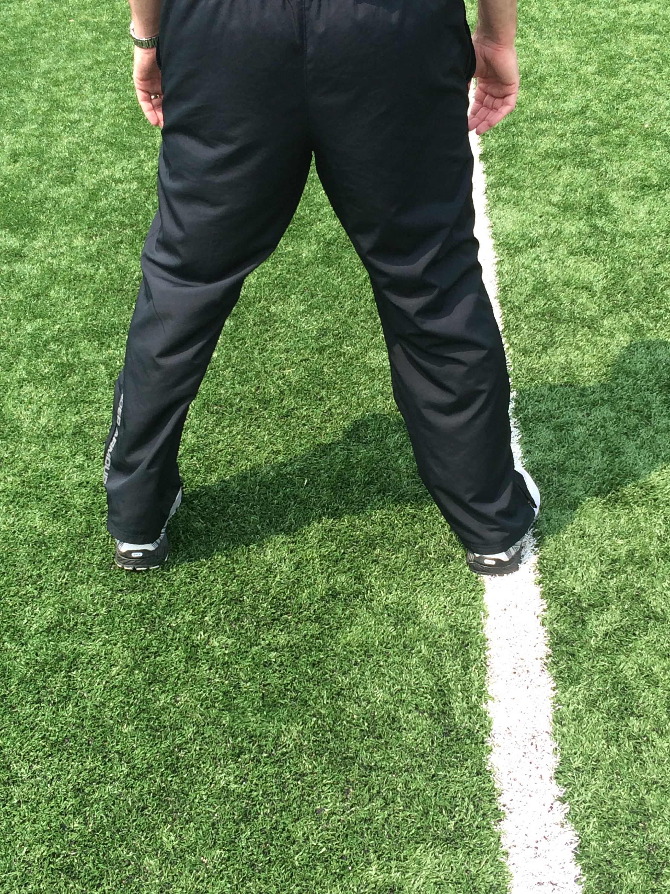
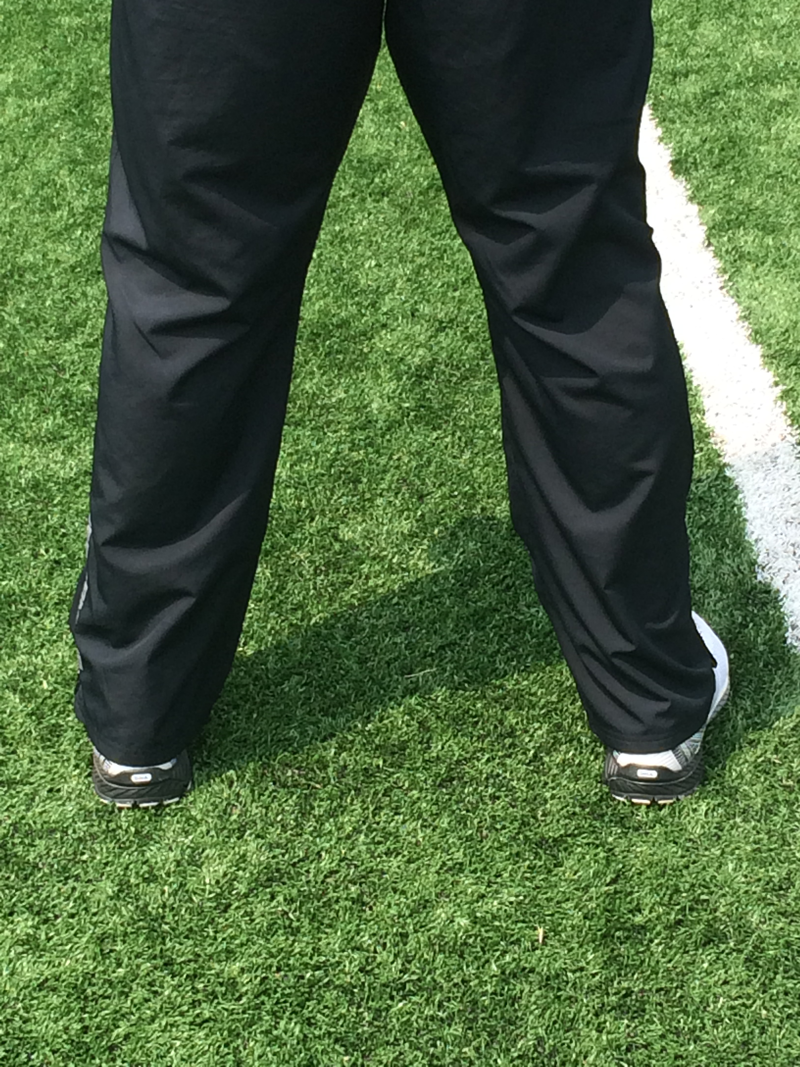
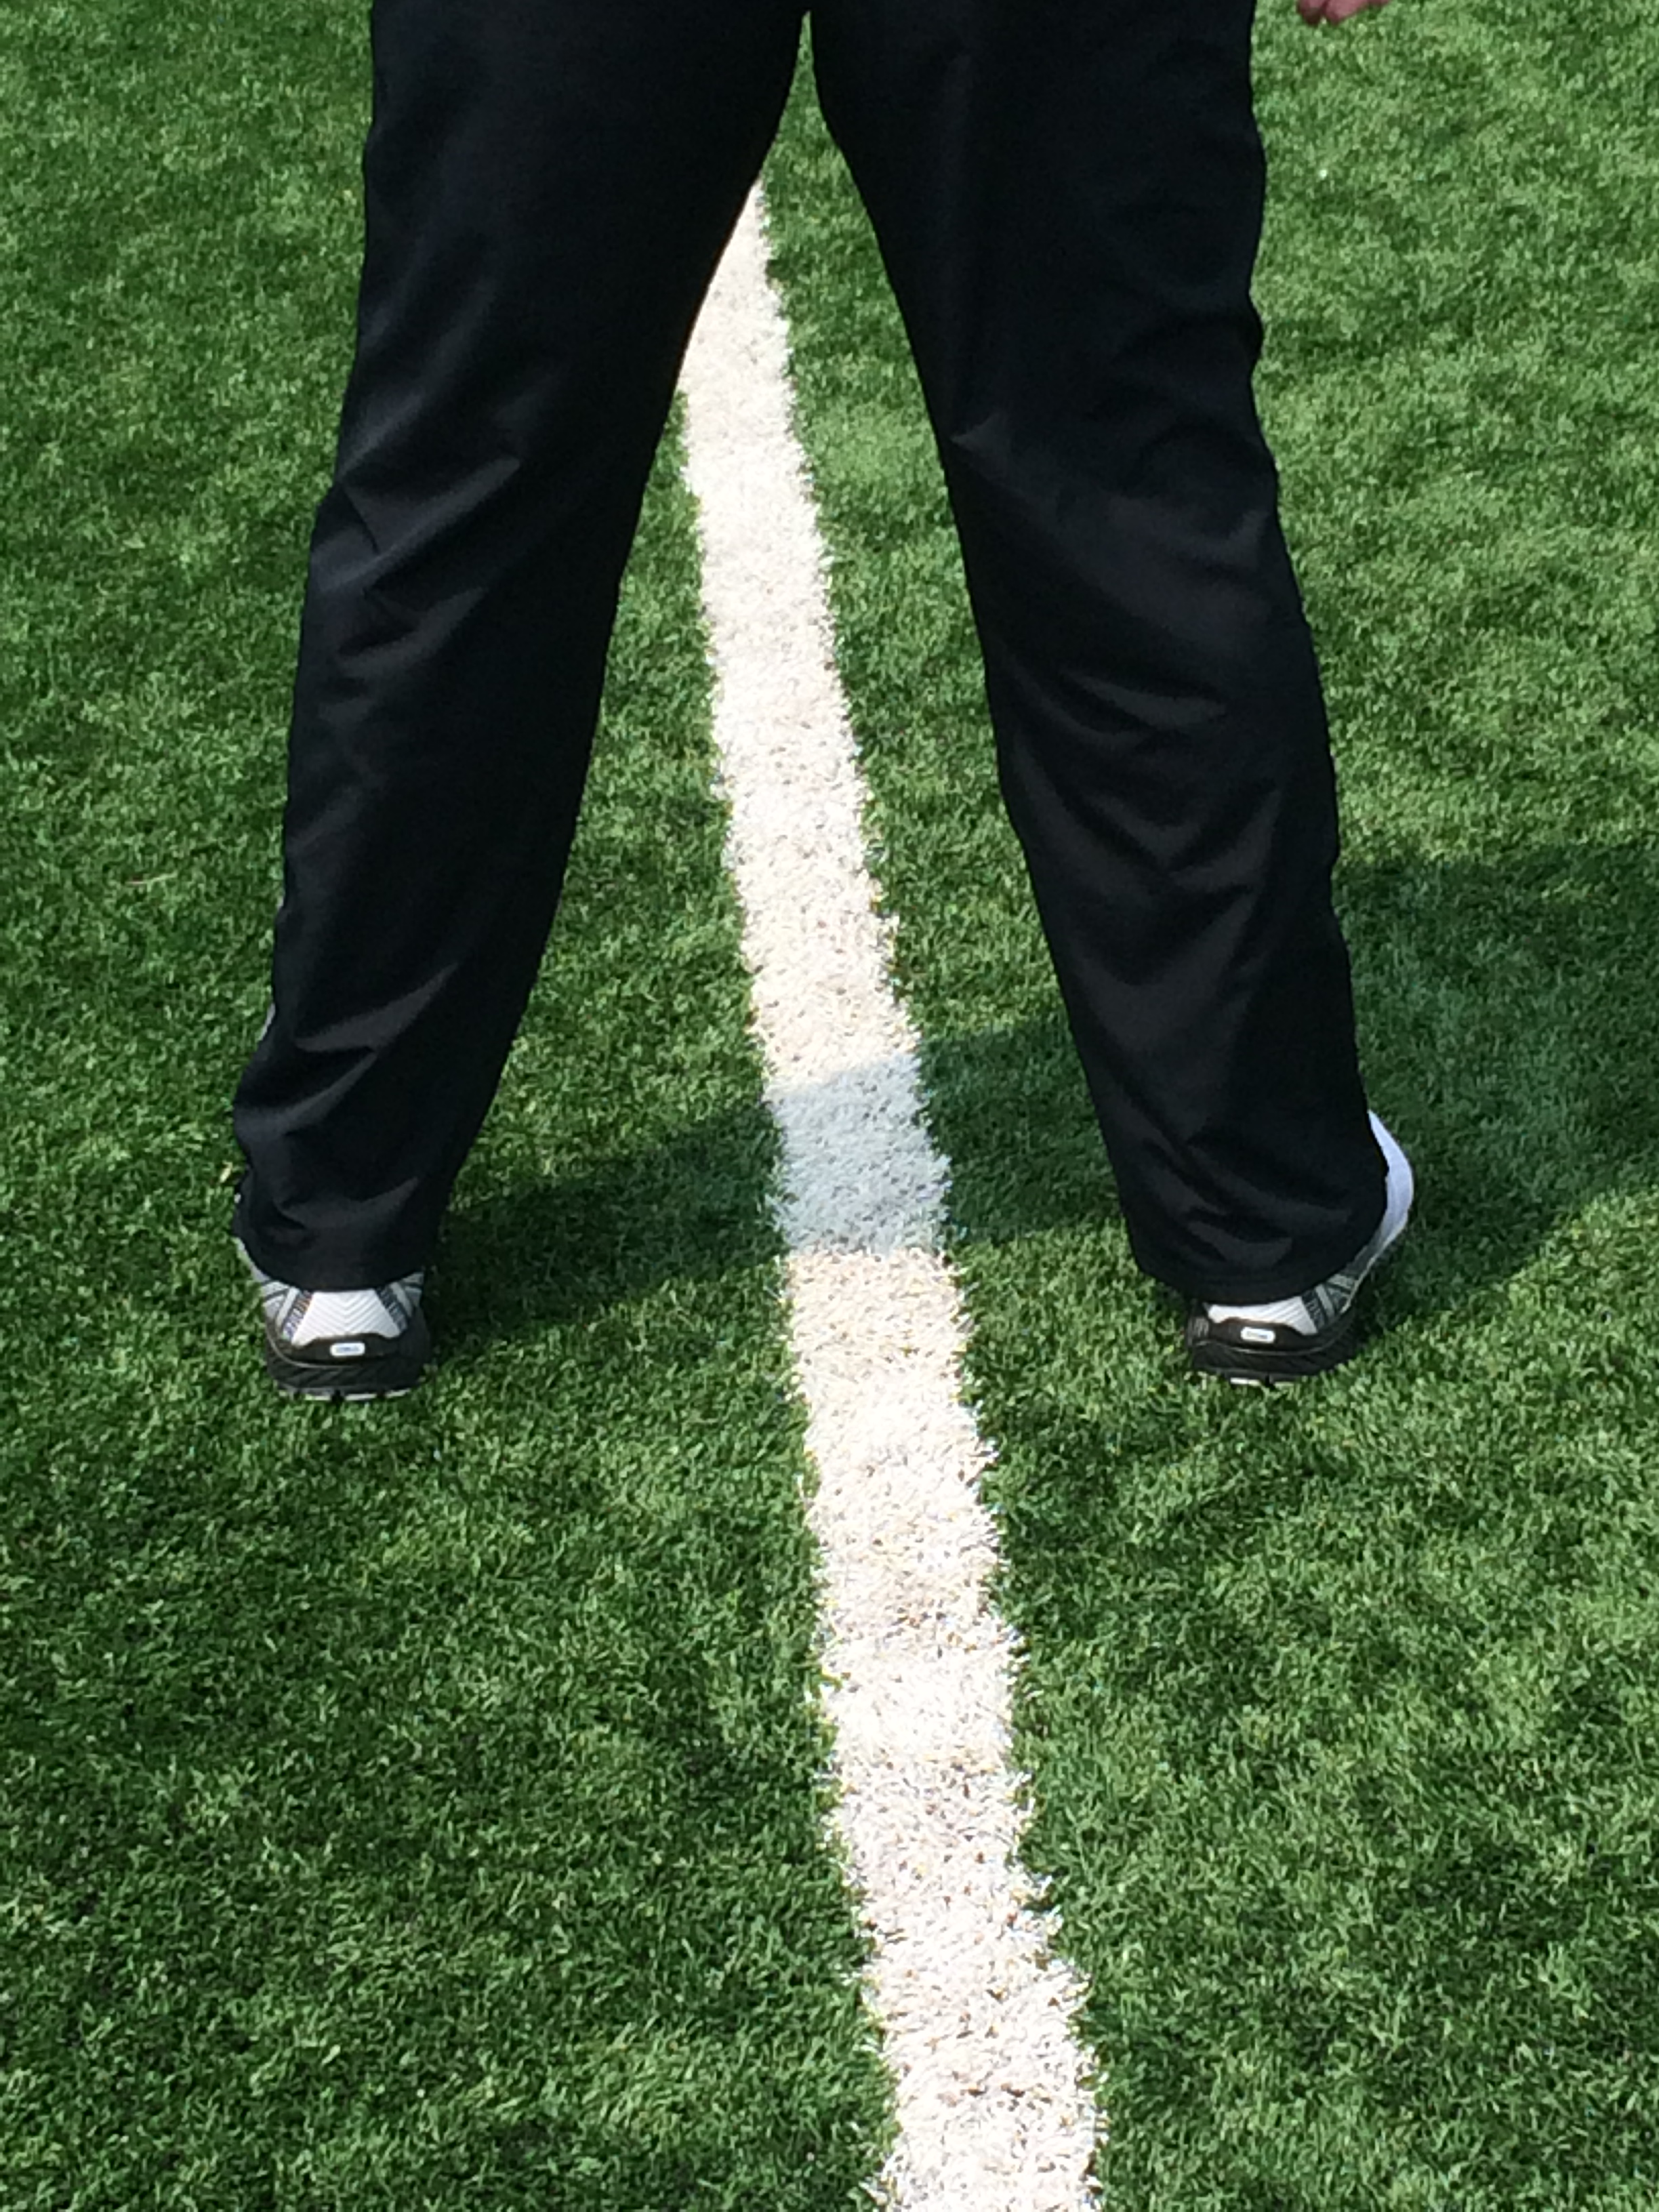
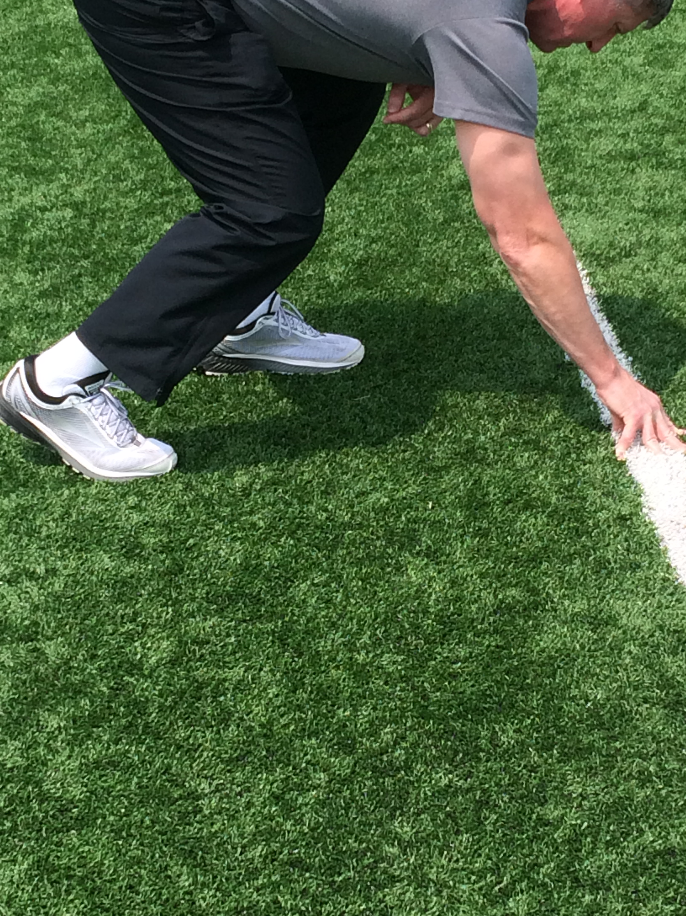
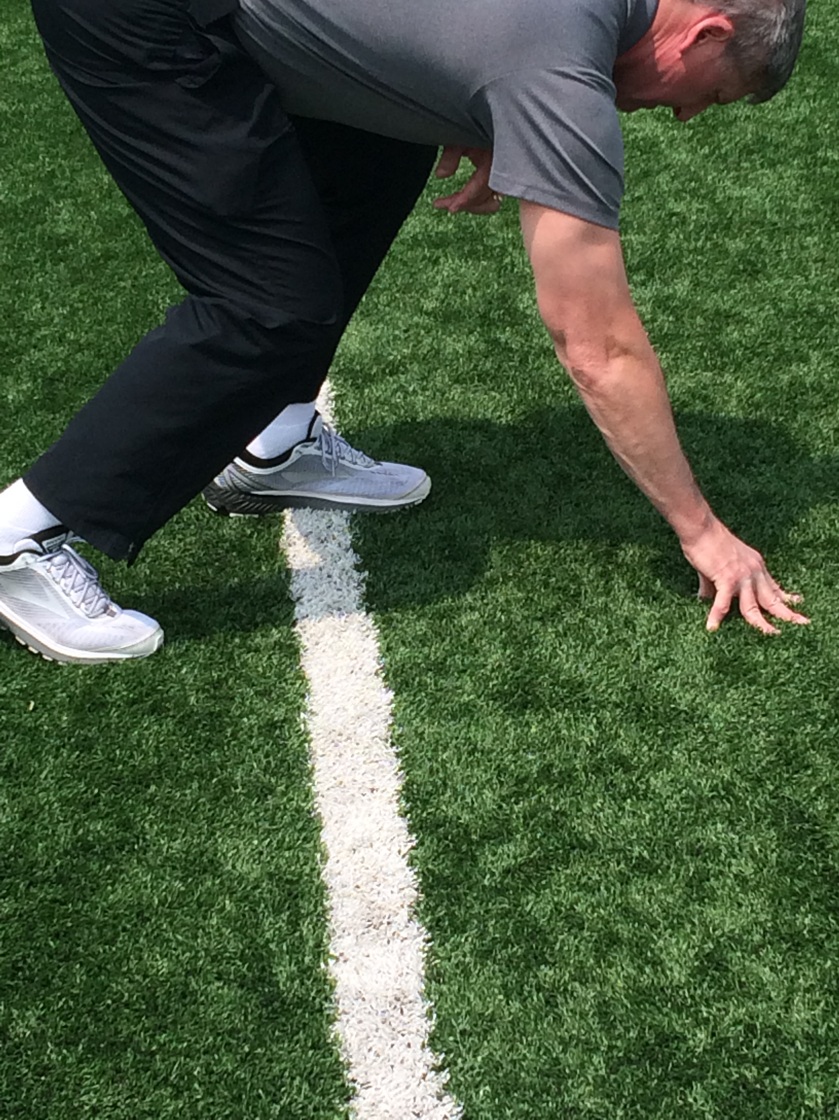
Legal or Illegal?

Slide 4
Crew Positioning
Regular Positions (Deep Kick)
R: At Goal line; Opposite press box
U: Team A’s restraining line; Opposite press box
HL: Team B’s restraining line; Opposite press box
L: At Goal line; Press box side
B: Team A’s restraining line; Press box side (After giving ball to Kicker)
Short Kick Positions (Determined by R)
R: At Goal line; Middle of field
U: Team A’s restraining line; Opposite press box
HL: Team B’s restraining line; Opposite press box
L: Team B’s restraining line; Press box side (Retreat on deep kick)
B: Team A’s restraining line; Press box side (After giving ball to Kicker)

Slide 8
Crew Mechanics & Coverage
Free Kicks

Slide 9
Referee
Count Team B; Confirm with L.
Sound whistle & give RFP when all officials have indicated ready.
Be prepared to rule on Team A formation at time of kick.
Remain at pylon until ball is possessed by Team B; Be alert for fair catch signal
Cover ball carrier if ball is caught in your zone; Key lead blocker if ball is caught in Line Judge’s zone.
Give wind clock signal when ball is legally touched in field of play.
Work with H to bracket ball carrier & be prepared to mark dead ball spot.

Slide 10
Umpire
Count Team A players; Confirm with B
Clear sideline; Verify Team A has complied with 9-yd mark requirement; Check Team A formation (Correct if possible)
Raise arm to signal Referee.
Following kick, move onto field towards inbounds line.
Key on kicker & 5 Team A players in the middle of formation.

Slide 11
Head Linesman
Count Team B players; Clear side line
Raise arm to signal R
Be prepared for onside kick (bean bag); Mark 1st touching
Following kick, maintain cushion & cover side line with R; Key 3 Team A players on your side.
Cover goal line, if necessary.

Slide 12
Line Judge
Count Team B; Confirm with R
Be prepared to rule on Team A formation at time of kick.
Remain at pylon until ball is possessed by Team B; Be alert for fair catch signal
Cover ball carrier if ball is caught in your zone; Key lead blocker if ball is caught in Referee’s zone.
Give wind clock signal when ball is legally touched in field of play.
Work with B to bracket ball carrier & be prepared to mark dead ball spot.

Slide 13
Back Judge
Count Team A players; Confirm with U
Give instructions to kicker; Take position
Clear sideline; Verify Team A has complied with 9-yd mark requirement; Check Team A formation (Correct if possible)
Raise arm to signal Referee
Following kick, maintain cushion & cover side line with L; Key 3 Team A players on your side.
Cover goal line, if necessary.

Slide 14
New Rule on Free Kicks:
If a Team B player makes a fair catch behind the 25-yd line, the ball belongs to Team B at its own 25-yd line.
The next snap shall be from position 3, unless a different position is selected before the play clock is at 25 seconds or before any subsequent RFP signal.
After the play clock is at 25 seconds or any subsequent RFP signal, the ball may relocated only after a charged team TO unless preceded by a Team A foul or offsetting fouls.

Slide 15
Penalty Enforcement
Team A Fouls:
All fouls except KCI:
Team B in possession at end of down: Previous spot OR Dead ball spot
Team A in possession at end of down: Previous spot
KCI:
Spot foul
Team B Fouls: (During kick)
Blocking after fair catch signal – Spot foul
Other fouls – Previous spot
Fouls after Team B possession – Spot of foul or dead-ball spot (3 & 1)

Slide 16
Scrimmage Kicks
Punts

Slide 17
Referee
Complete pre-snap routine.
Take position at the side of the kicker, wide enough to see the ball from the snap to the kick.
Be in a position even with, or slightly in front of kicker when the ball is kicked. Warn kicker regarding end line if kicking from his own EZ.
Signal U (open hand on chest) if Team A is not in legal scrimmage kick formation.
Watch blocking & illegal action by players behind LOS and action by and against the kicker.
After kick, watch players while proceeding slowly downfield.

Slide 18
Umpire
Complete pre-snap routine.
If in “obvious scrimmage kick formation”, take position on offense’s side of ball, to the side of kicker on opposite side from R.
Observe initial charge at LOS. Check Team A blocks and actions by Team B players. *Action vs snapper.
After 1st wave advances downfield, move toward return area. Observe center area for illegal actions.

Slide 19
Head Linesman
Complete pre-snap routine.
After initial charge, observe offensive backs for holding & defensive holding in line area.
Primary to know if kick crosses NZ.
Short kicks: watch for 1st touching, KCI, fair catch signals.
On return, cover in front of runner after catch/recovery. Maintain until runner cuts to opposite side of field OR, if on your side, is picked by you.
Responsible for your entire sideline.

Slide 20
Line Judge
Complete pre-snap routine.
After initial charge, observe offensive backs for holding & defensive holding in line area.
Stay on line until kick is made, then move downfield (easy run).
Short kicks: watch for 1st touching, KCI, fair catch signals.
On return, cover in front of runner after catch/recovery. Maintain until runner cuts to opposite side of field OR, if on your side, is picked by you.
Responsible for your entire sideline.

Slide 21
Back Judge
Complete pre-snap routine.
Take position outside & behind deep receivers so that you have best view of catch. Adjust to play area & flight of kick. Mark end of kick (bean bag).
Observe actions by & against returner – 1st touching, KCI, fair catch (blocking), etc.
Short kicks, observe action in front of ball.
Cover GL, if threatened, to determine kick in EZ.

Slide 23
Scrimmage Kicks
Field Goal & PAT

Slide 24
Referee
Position so that you can see ball spotted for kick – several yards to the side of kicker, favoring L’s side.
If run or pass, cover as usual. Assist in sideline coverage to L’s side.
Signal U if Team A is not is legal scrimmage kick formation.
Signal score after being positive that requirements are met.
Rule on roughing or running into kicker/holder.

Slide 25
Umpire
Adjust position to favor L’s side. Adjust depth based on length of kick.
Observe blocks by OL & actions by defensive players.
Protect snapper.
Assist in GL coverage if run develops to L’s side.

Slide 26
Head Linesman
Responsible for legality of snap & entire LOS.
Move to GL if run develops.
Know if kick crosses the NZ.
After kick, move onto field to dead ball officiate.

Slide 27
Line Judge
Responsible for your upright. Ball must pass inside to be good. Coordinate signal with B.
If run develops, move to back pylon to rule on sideline, then to GL to assist.
Short kick & ball is live, officiate as a scrimmage kick.
If “Swinging gate” or regular formation, remain in regular positon, then shift when team shifts to scrimmage kick formation.
If scrimmage kick formation then shift to another formation, move to end line corner, then down sideline toward regular position.
Rule on GL, if necessary.

Slide 28
Back Judge
Responsible for your upright & cross bar. Ball must pass inside upright to be good. Coordinate signal with L.
If run develops, move to GL to assist.
Short kick & ball is live, officiate as a scrimmage kick.
Sound whistle when ball becomes dead.

